Slide 1
Recert Exam 2015 Part A v. 1
Questions 9-16

Slide 2
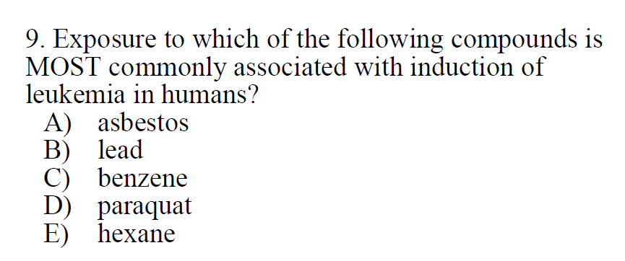

Slide 3
A) Eliminate – asbestos is associated with lung disease and lung cancer
B) Eliminate – Lead is associated with cancer, but not leukemia
lung/brain, kidney in rodents
C) Correct – Epi studies support association of benzene exposure with acute myelogenous leukemia (C&D 7th Ed. P. 1007).
D) Eliminate – Lung and kidney effects.
E) Eliminate – low acute toxicity, effects similar to other solvents

Slide 4
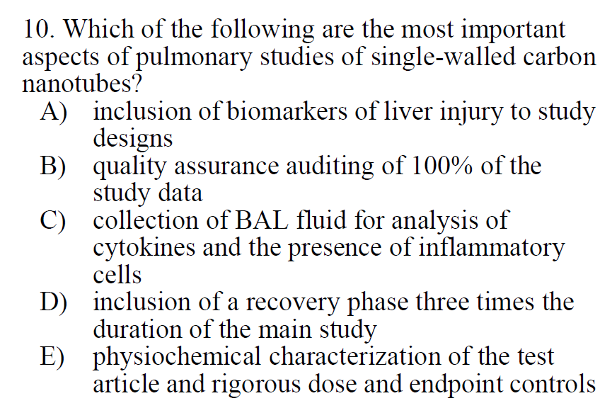

Slide 5
A) not relevant
B) Relevant in general, but not best choice
C) Relevant to lung/inhalation studies, but not best choice
D) Mentioned in book without the length of time – not best choice
E) Best choice – these aspects are of “utmost importance”. (C&D Essentials p. 420)

Slide 6
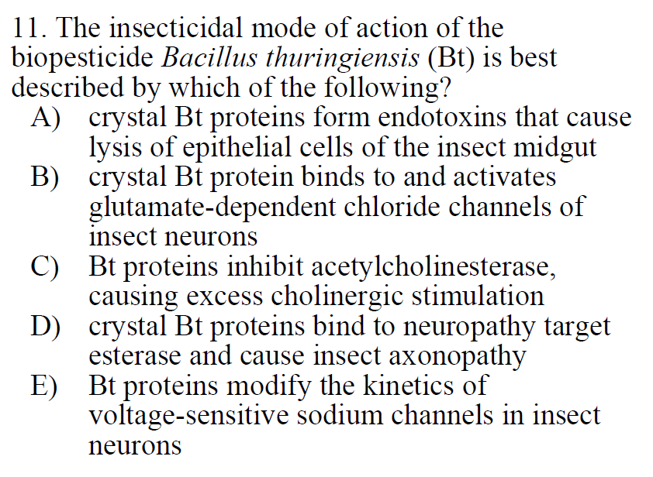

Slide 7
MOA requires crystal Bt proteins, so eliminate C and E
A) Correct – C&D 7th Ed p. 910
B) Eliminate - Avermectins bind to/activate glutamate-dependent chloride channels
D) Eliminate – OPs bind to NTE
E) Eliminate – Type I/II Pyrethroids, DDT, and Dihydropyralozes modify kinetics of sodium channels

Slide 8
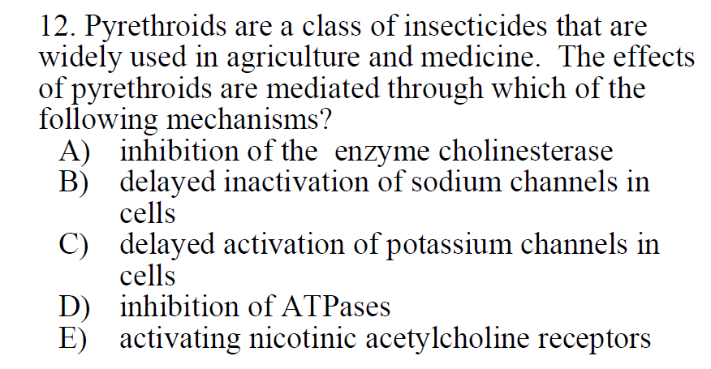

Slide 9
A) Eliminate – Of note, cholinesterase can refer to AChE and Butyrylcholinesterase
OPs and Carbamates inhibite AChE
B) Correct – Pyrethroids (Type I/II) slow inactivation of Na+ channels leading to a stable, hyperexcitable state (C&D Essentials p.339).
Type II Pyrethroids bind and inhibit GABA-gated chloride channels
C) Not relevant to insecticides?
D) Eliminate – Chlordecone (an organochlorine) likely exerts toxic effects through inhibition of ATPases (C&D 7th p. 904-5)
E) Eliminate – Nicotine and Neonicotinoids activate nicotinic acetylcholine receptors

Slide 10
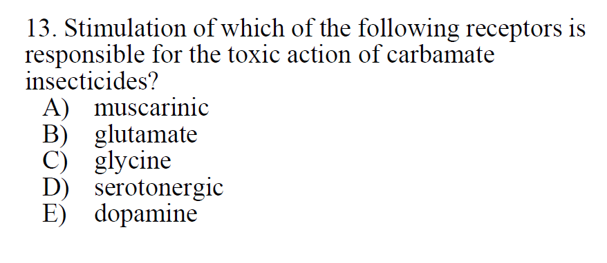

Slide 11
Examples of carbamate:
Carbaryl
Aldicarb
A) Correct: Carbamates inhibit AChE = accumulation of acetylcholine at cholinergic synapses = overstimulation of muscarinic and nicotinic receptors.
B) AMPA and NDMA receptors
C) Glycine and NMDA receptors
D) Serotonergic refers to neurons. Serotonin binds to numerous 5-HT receptors.
E) Dopamine receptors, TAARs

Slide 12
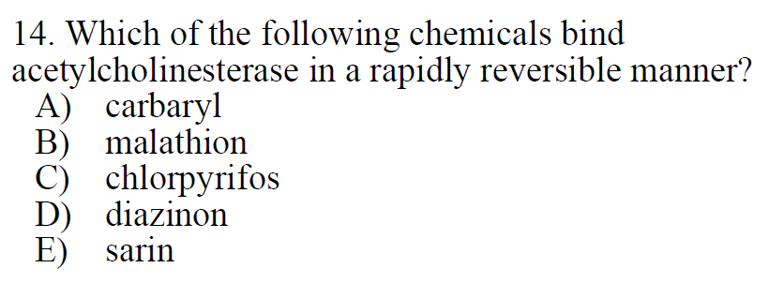

Slide 13
Other carbamates include:
Aldicarb
Carbofuran
Propoxur
A) Correct – Carbaryl (a carbamate) rapidly and reversibly binds AChE
B) Malathion is an OP (hydrolyzed slowly, irreversible binding to AChE when “aged”)
C) Chlorpyrifos is an OP
D) Diazinon is an OP
E) Sarin is an OP

Slide 14
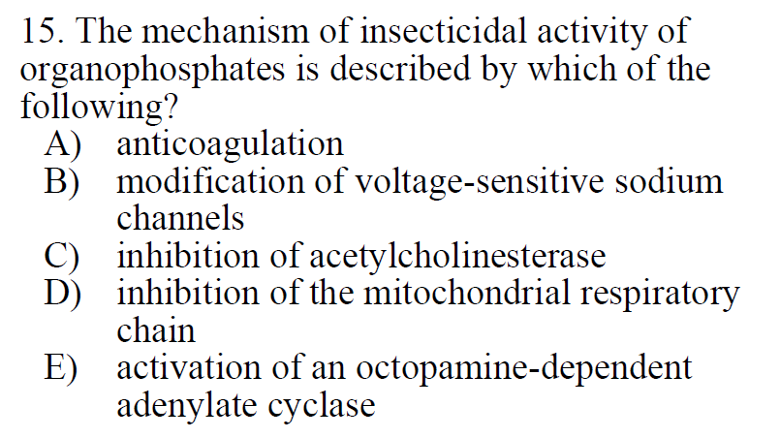

Slide 15
A) Coumarin derivatives, Warfarin
B) Pyrethroids, DDT, Dihydropyrazoles
C) Correct
D) Rotenoids (Rotenone)
E) Formamidines (Chlordimeform, Amitraz)

Slide 16
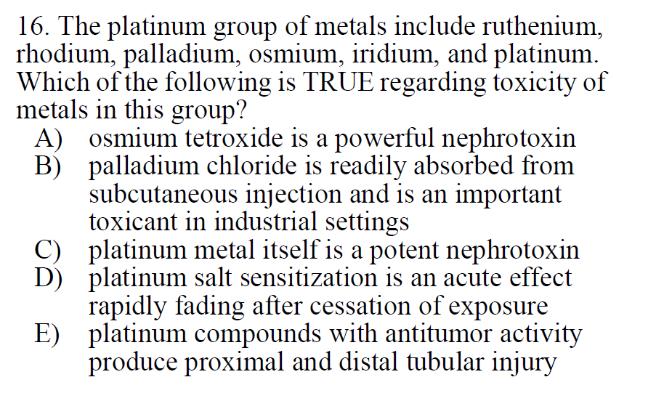

Slide 17
A) Pulmomary edema
B) Palladium is poorly absorbed
C) Platinum metal affects skin and lung (hypersensitivity)
D) Effects may persist for years (C&D 7th Ed. P. 963)
E) Correct (C&D Essentials p. 358)

